Slide 1
Recognizing Handwritten Digits
Jedidiah Harwood, Darya Petrov, Kevin Xu, Katya Katsy

Slide 2
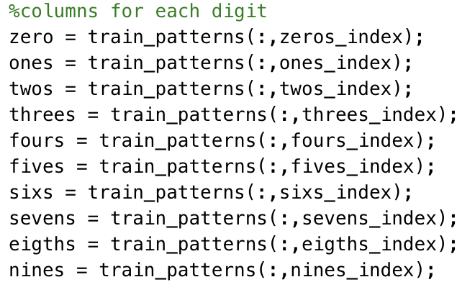
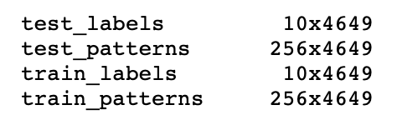
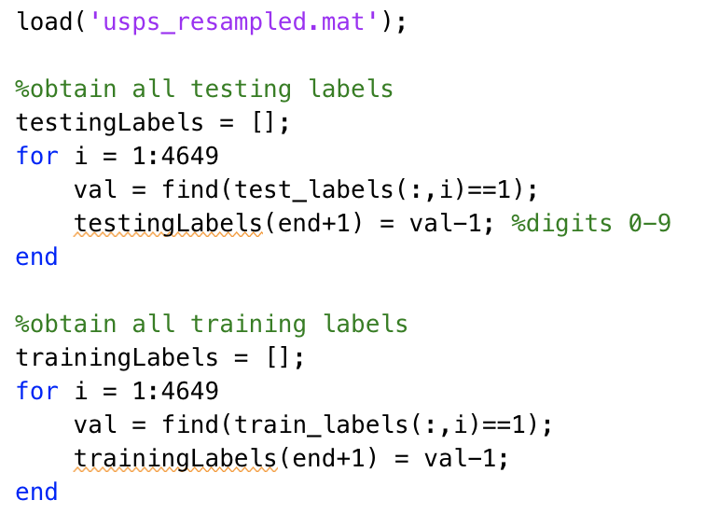
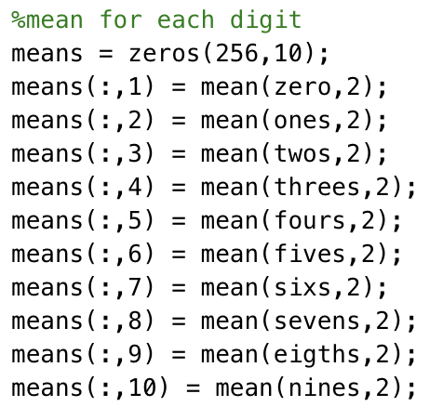
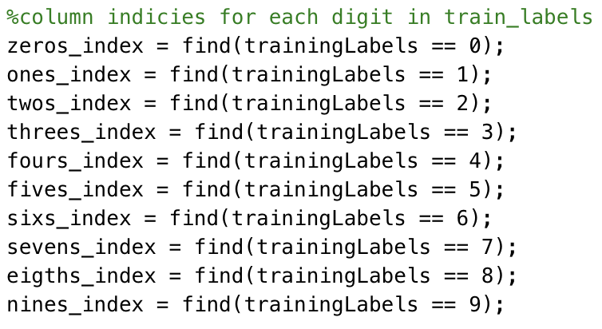
Data Preprocessing
USPS handwritten digit data
9298 total images (16x16)
Training set: 4649 images
Testing set: 4649 images
The *_patterns variables 16x16 grey level pixel intensities, scaled to the range [-1, 1]
The *_labels variables contain encode with values -1 and +1 of the classification with one +1 per column
Possible labels 0-9

Slide 3
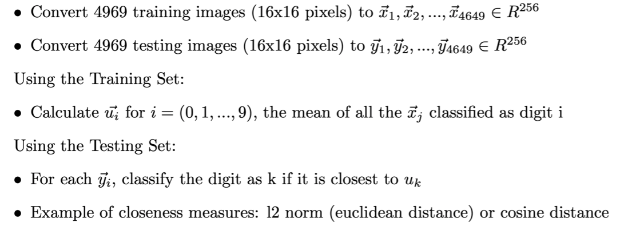
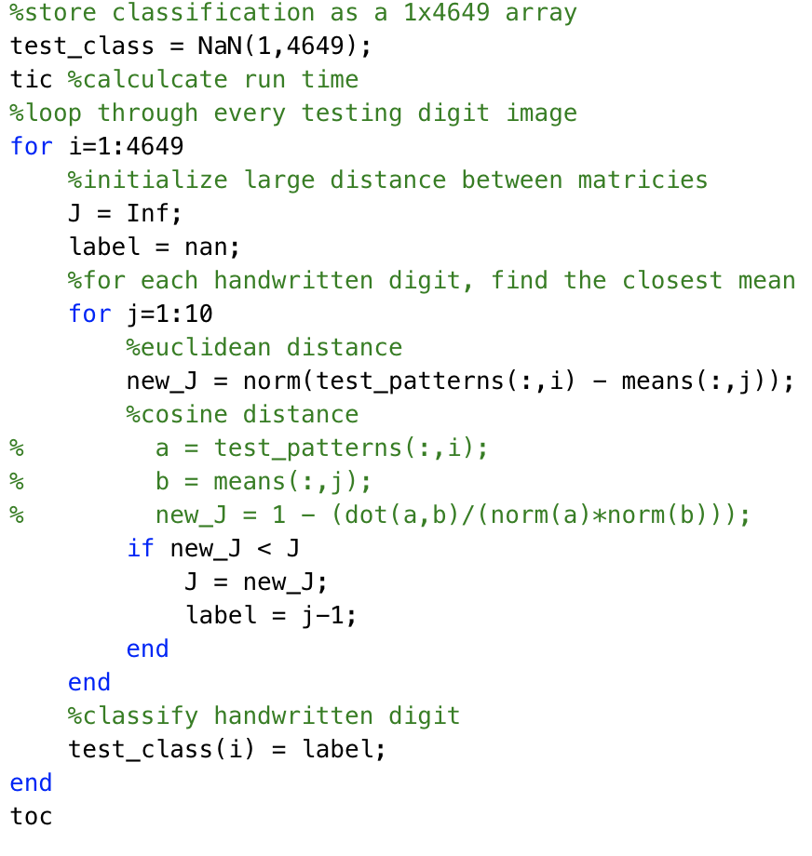
Simple Classification Algorithm
Results
Euclidean Distance Accuracy: 86.44%, Run Time: ~ (0.1 - 0.2) seconds
Cosine Distance Accuracy: 84.51%, Run Time: ~ (0.1 - 0.2) seconds
Flaws
algorithm doesn't use any information about the variance of handwritten digits

Slide 4

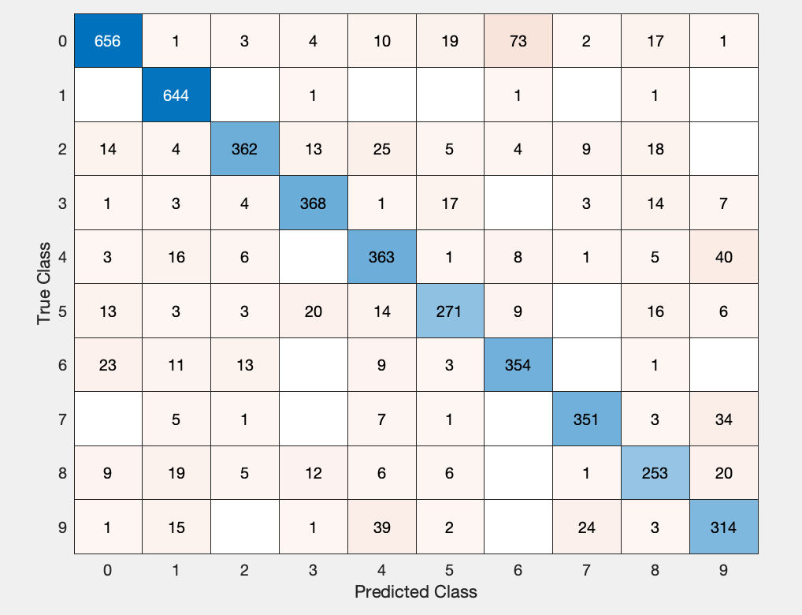









Simple Classification Results
Mean Digits
0
1
2
3
4
5
6
7
8
9

Slide 5
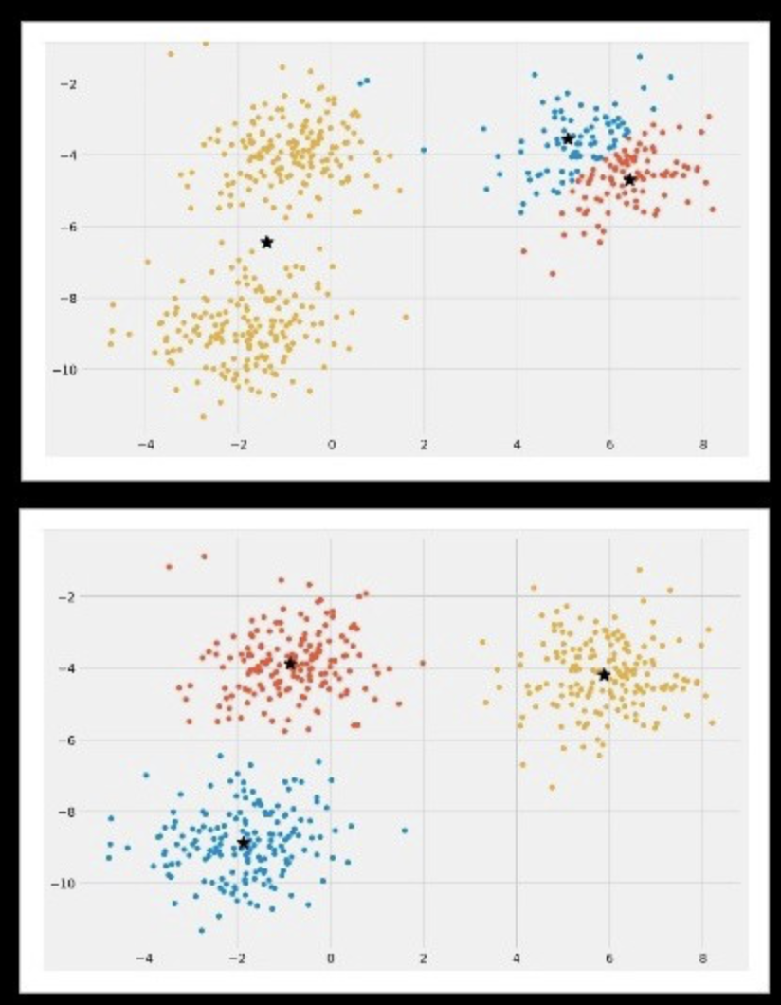
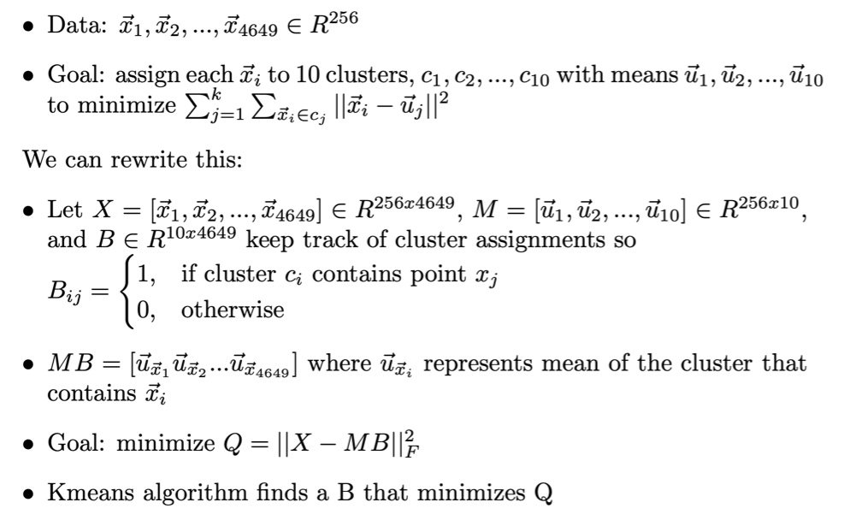
K Means Clustering
Algorithm
Initialize 10 random cluster means (one cluster mean for each digit 0-9)
(K Means ++) Higher probability of being initialized further away from each other
For each handwritten digit, assign it to the closest cluster mean
For each of cluster C_i (i=1,...,10), calculate the mean of all the handwritten digits in cluster C_i
Repeat steps 2-3 until convergence
After convergence, classify each cluster to represent a digit by the closest digit mean
Flaws
Cluster Assignments for K Means ++
Finding local instead of global minima
Initialization sensitivity
K Means % Accuracy:
K Means ++ % Accuracy:
K Means Run Time:
K Means ++ Run Time:

Slide 6
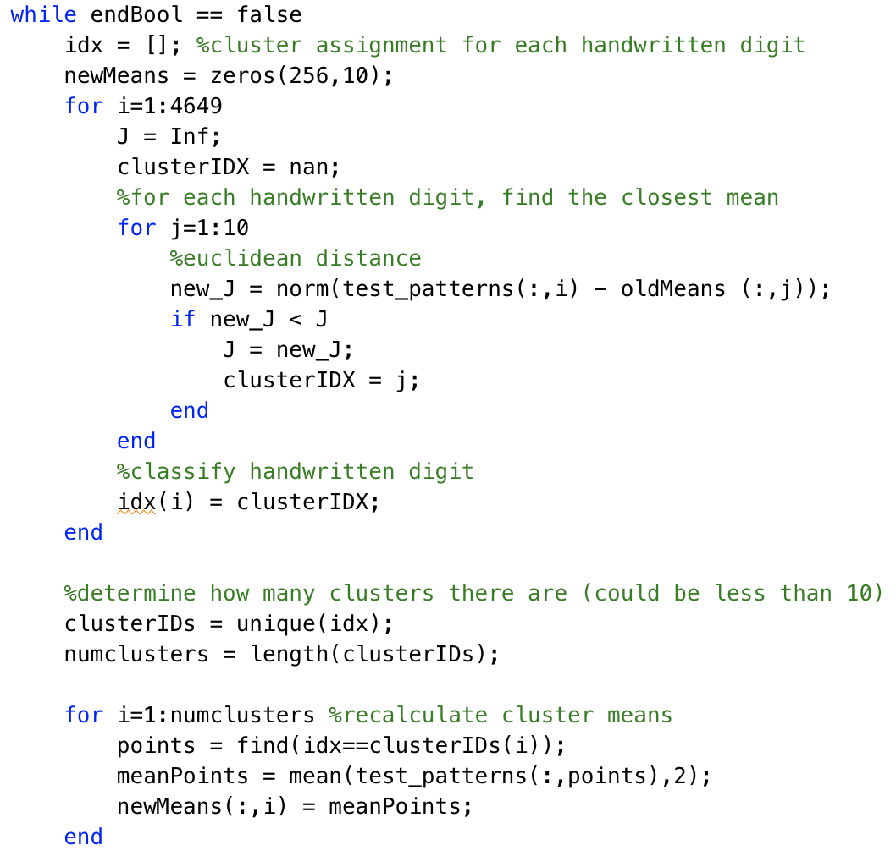
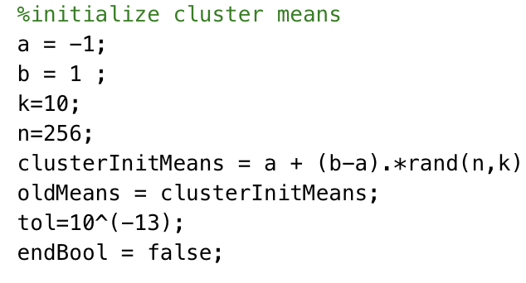
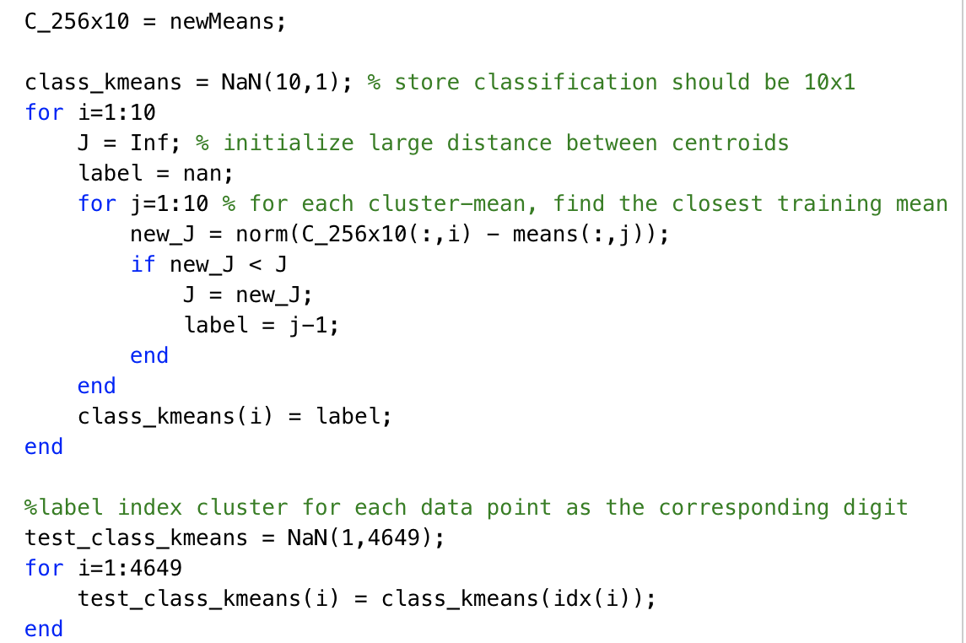
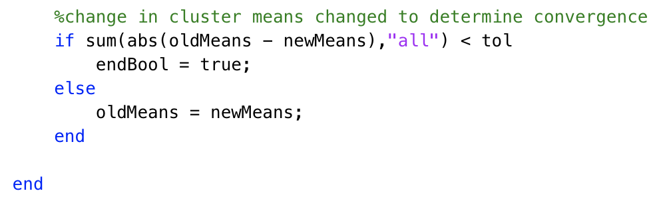
K Means Code
step 1
step 2
step 5
step 3
step 4

Slide 7
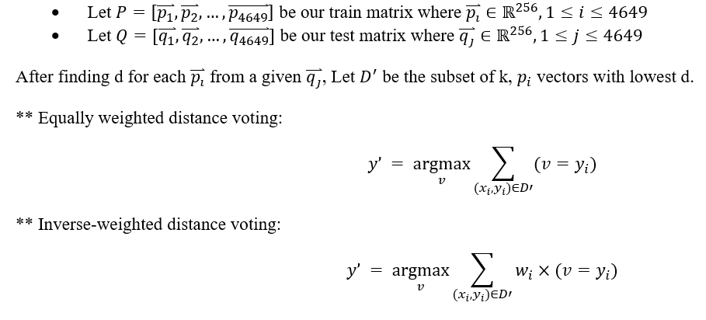
K-Nearest-Neighbors Algorithm
Weighting is commonly inverse wrt distance: w_i=1/d_i

Slide 8
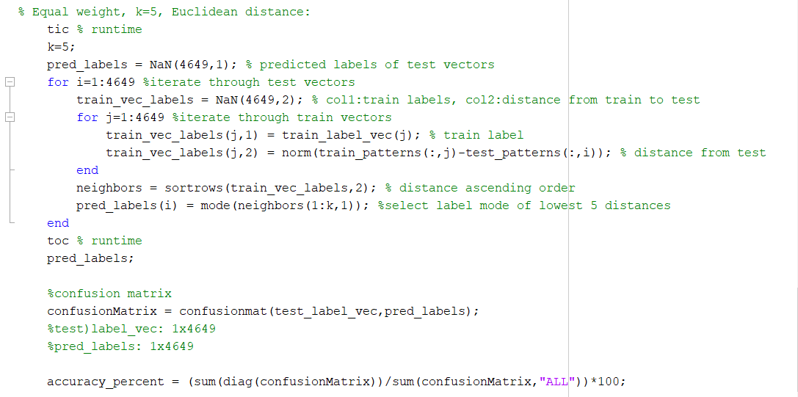
Algorithm:
0: Pick small positive integer k
1: Find distance of input vector to all other vectors in dataset.
2: Extract k vectors with lowest distances
If weighted: assign w=1/d to k nearest data points.
3: Assign class label to input vector:
Unweighted: most common label out of the k vectors.
Weighted: highest scoring y_i label associated with score: Sum((w_i) . (v = y_i)), out of the k nearest x_i vectors.
Flaws:
Need to determine k, High computational cost, High storage, Suitable distance for the dataset should be used
Accuracy: 96.6%,
Run Time: 56.23s

Slide 9
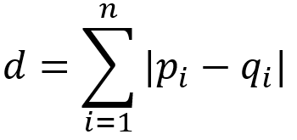
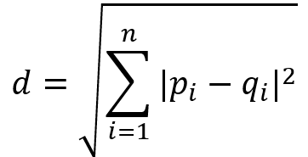
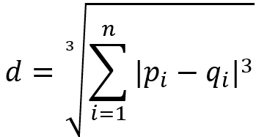
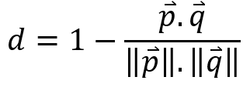
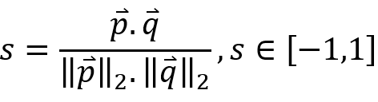

Manhattan | Euclidean | Cubic | Cosine
Cosine Distance
More robust than Minkowski distances for comparing vectors of highly differing magnitude (considers unit vectors).
Cosine Similarity: Cosine Distance
s = 1: if p and q are parallel
s = 0: if p and q are orthogonal
s > 0: almost parallel
s < 0: almost antiparallel
s = -1: antiparallel

Slide 10
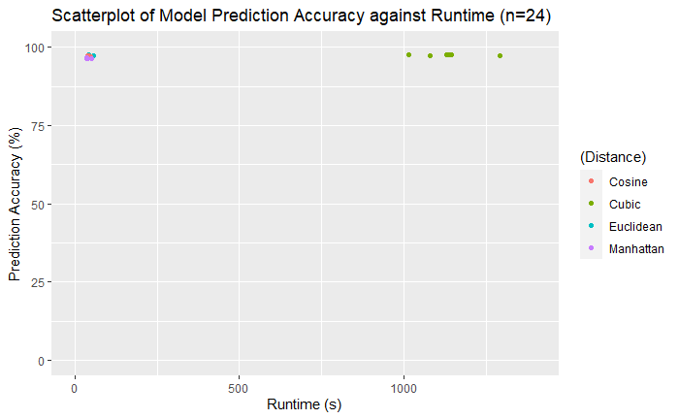
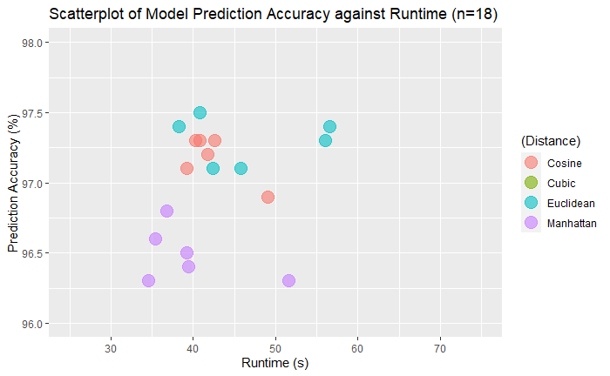
kNN Performance
These computations use 10-fold cross validation (10% testing, 90% training) with combinations: k=1,3,5, Inverse Weighted or Equally Weighted, Euclidean, Cosine, Cubic distance
Euclidean distance
Inverse Weight |  |  | Equal Weight
k=1 | k=3 | k=5 | k=1 | k=3 | k=5
97.4%, 38.3s | 97.5%, 40.84s | 97.1%, 42.44s | 97.4%, 56.6s | 97.3%, 56.024s | 97.1%, 45.8s
Cosine distance
Inverse Weight |  |  | Equal Weight
k=1 | k=3 | k=5 | k=1 | k=3 | k=5
97.3%, 42.65s | 97.3%, 40.28s | 97.1%, 39.173s | 97.3%, 40.86s | 97.2%, 41.80s | 96.9%, 49.06s
Cubic distance
Inverse Weight |  |  | Equal Weight
k=1 | k=3 | k=5 | k=1 | k=3 | k=5
97.7%, 1144.6s | 97.5%, 1134.5s | 97.4%, 1079.4s | 97.6%, 1129.3s | 97.4%, 1292.5s | 97.5%, 1015.4s
Manhattan distance
Inverse Weight |  |  | Equal Weight
k=1 | k=3 | k=5 | k=1 | k=3 | k=5
96.3%, 34.6s | 96.8%, 36.8s | 96.5%, 39.2s | 96.3%, 51.582s | 96.6%, 35.43s | 96.4%, 39.4s

Slide 11
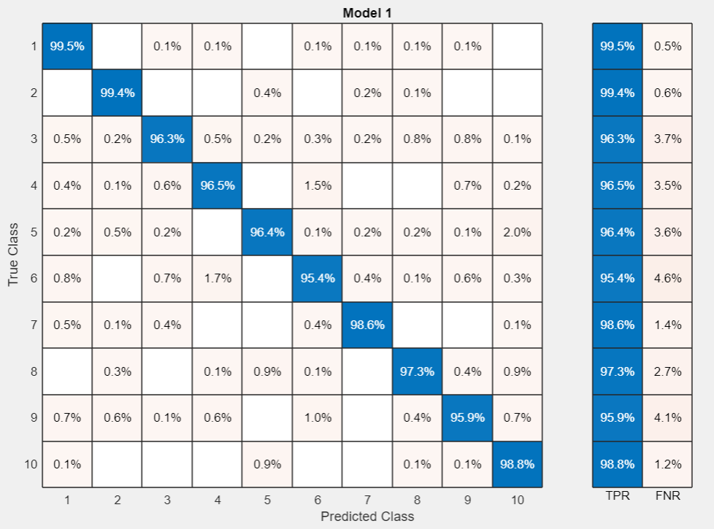
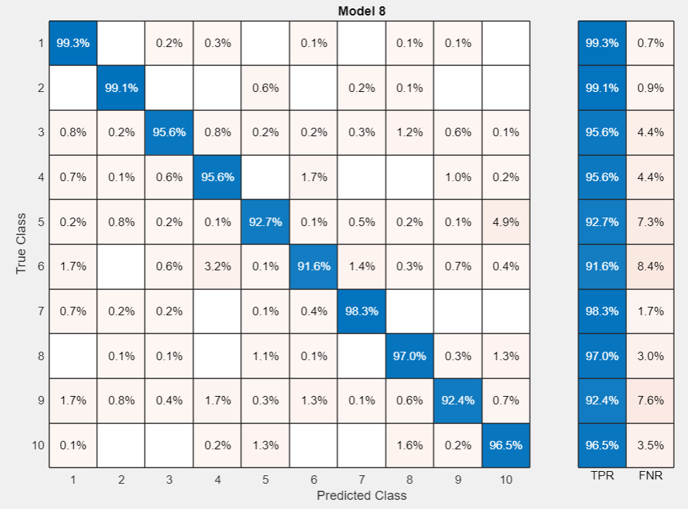
Highest accuracy:
Lowest Run time:

Slide 12
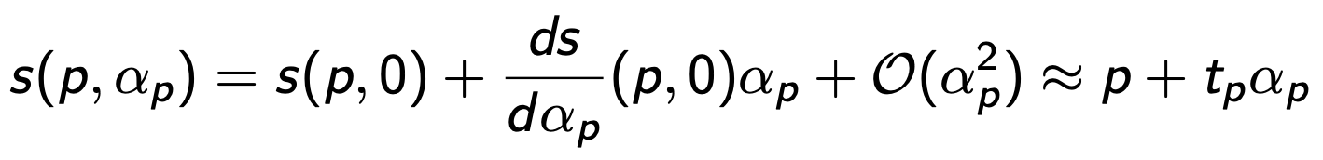
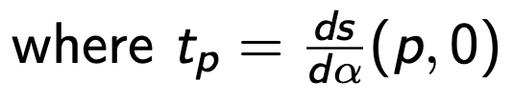
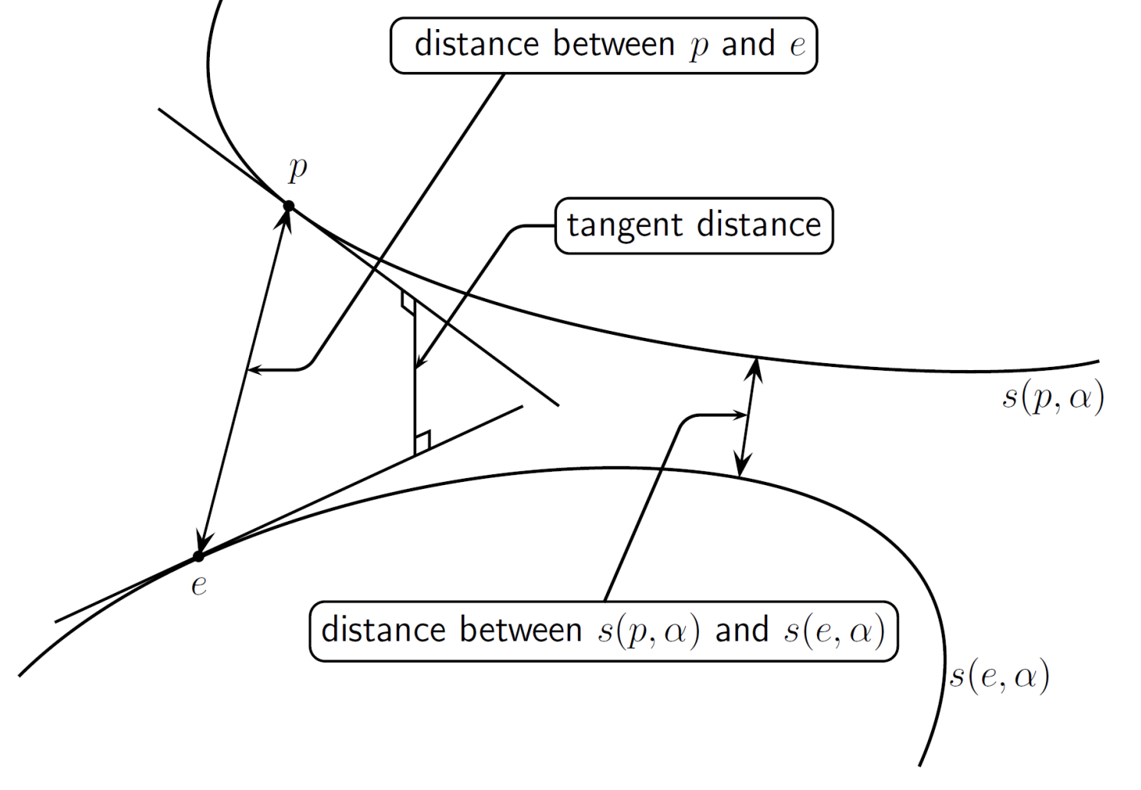
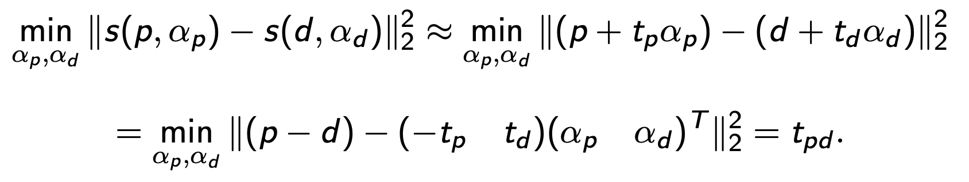
Tangent Distance Algorithm
Background
• s(p, α_{p}) → rotations of the digit p by a parameterized curve, where α_{p} is the angle of rotation
• transformation types: horizontal/vertical shift, rotation, scaling, thickness
• small rotations have minimal effect on tangent distance, unlike Euclidean distance
A Least Squares Problem
• to find distance between digits p and d, need distance s(p, α_{p}) and s(d, α_{d})
• parametrized curves ≈ Taylor expansion
• tangent distance = min distance between curves
• α_{p} is only one transformation → what if more?

Slide 13
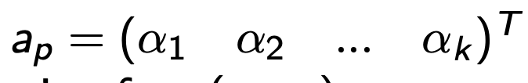
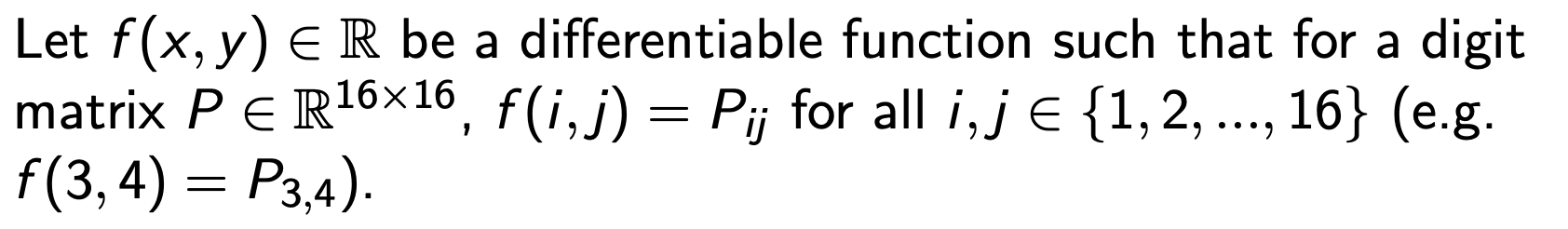
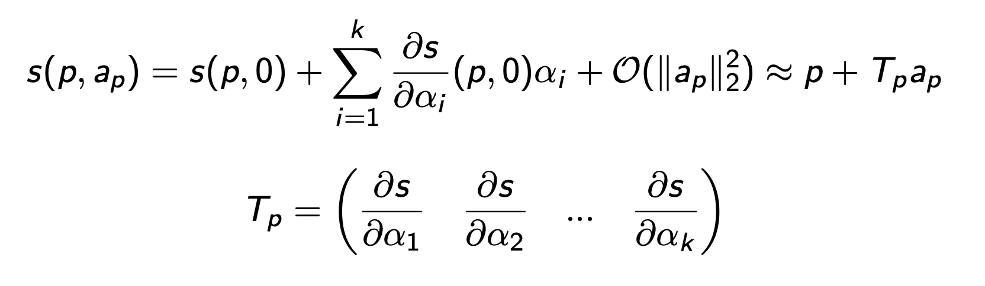
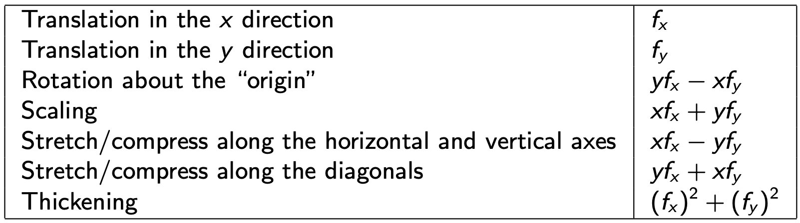
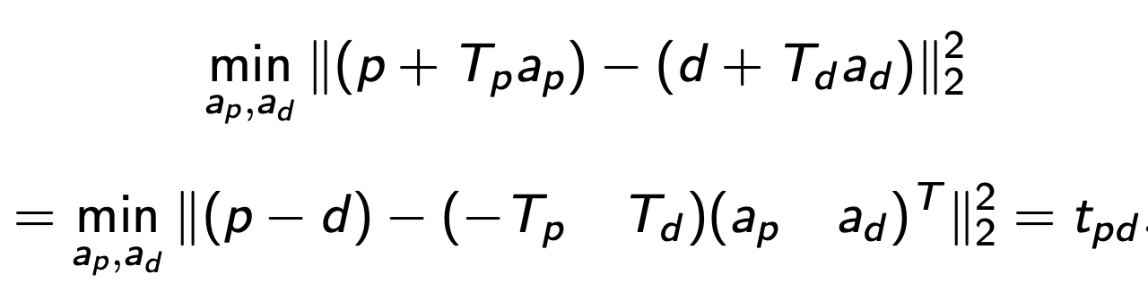
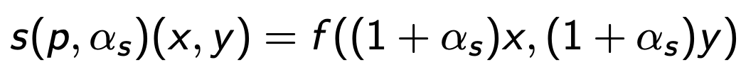
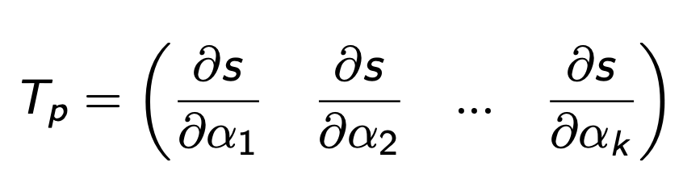
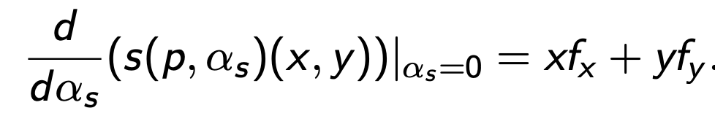
Tangent Distance Algorithm
A Least Squares Problem (continued)
• k transformations on p:
• Multivariate Taylor expansion:
• Multivariate tangent distance:
• T_{p} → matrix of derivatives of transformations
Transformations
• derivatives of the transformations at α = 0:
• example for scaling: plug transformation in f(x,y), differentiate using chain rule

Slide 14
Tangent Distance Algorithm
Algorithm
Code for Horizontal Transformation
For each train/test image:
Find f_{x} and f_{y} of image
Determine transformation function: T_{x} = f_{x}
For each test image, p:
For each train image, d:
Subtract train p from test d
Compute tangent matrices and combine
Solve least squares problem
Get residual
Find minimum residual among train images
Set prediction to label of smallest residual
p_x_train = []; p_y_train = [];
for i = 1:len_train
image = reshape(train_data(:,i),[16,16])';
[Gx,Gy] = imgradientxy(image);
Gx_flat = reshape(Gx,[1,256]);
Gy_flat = reshape(Gy,[1,256]);
p_x_train = [p_x_train; Gx_flat];
p_y_train = [p_y_train; Gy_flat];
predictions = [];
for t = 1:len_test
residuals = [];
for r = 1:len_train
A = [-p_x_train(r,:); p_x_test(t,:)]';
b = train_data(:,r) - test_data(:,t);
[x,flag,relres] = lsqr(A, b);
residuals = [residuals relres];
[min_resid,ind] = min(residuals);
disp(min_resid)
predictions = [predictions train_labels(ind)]

Slide 15
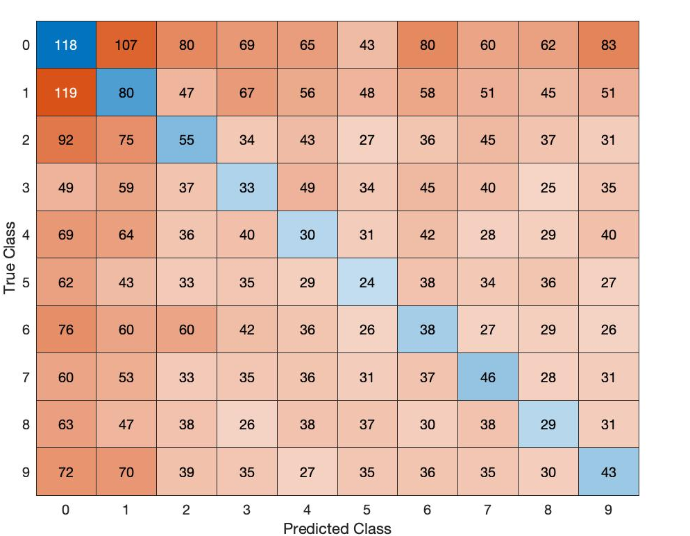
Tangent Distance Algorithm
Results
USPS dataset + our implementation:
10.66%, not much better than random
2417 seconds = 40 minutes
MNIST + outside source:
21.35% without smoothing
91.41% with smoothing
Challenges
• works poorly without smoothing
• much slower and more expensive
• length(test)・length(train) # of comparisons
• does not significantly outperform other methods

Slide 16
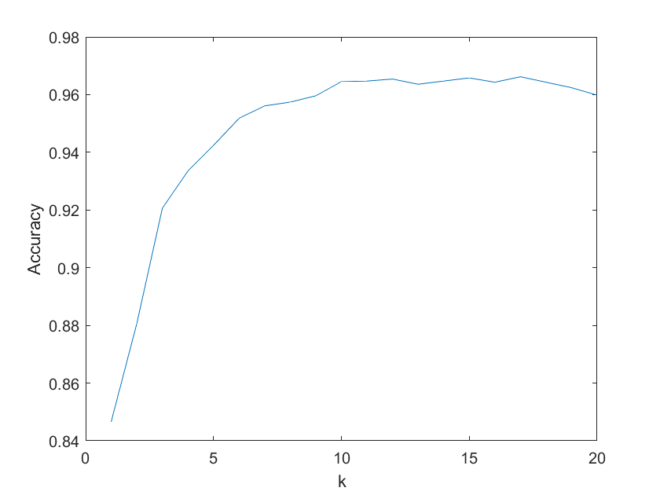
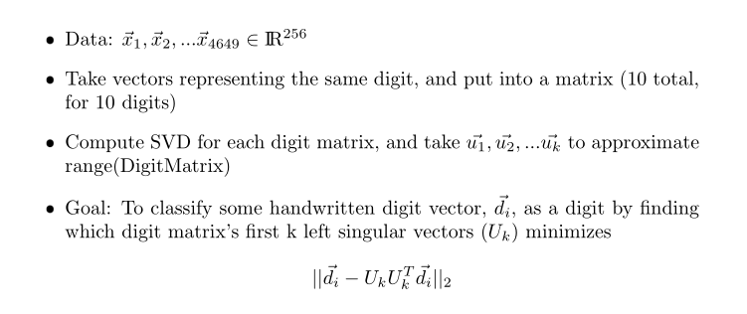
SVD Classification Algorithm

Slide 17
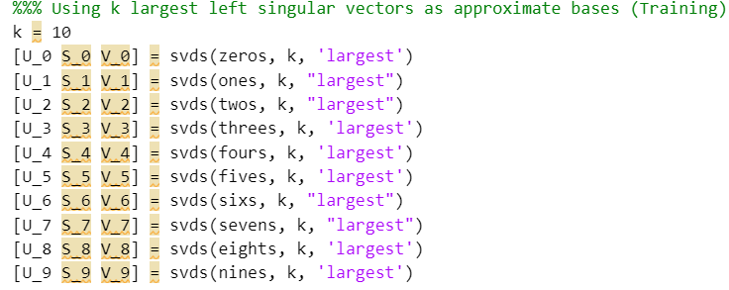
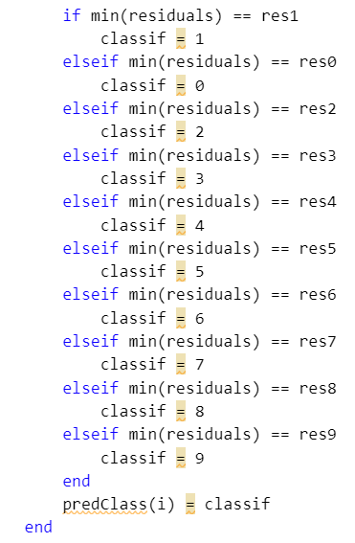
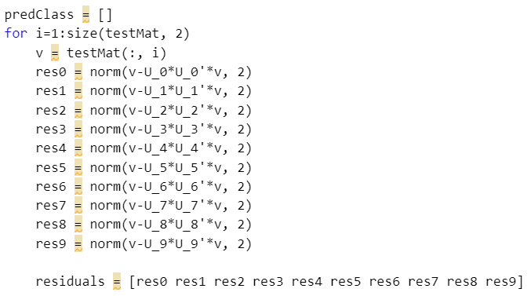
MATLAB Code

Slide 18
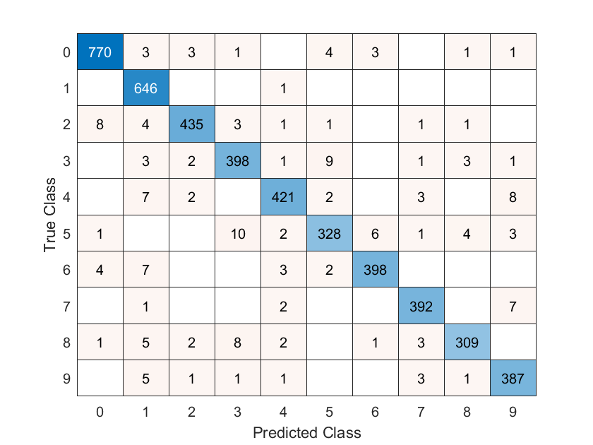
Results of SVD
Accuracy: 96.45%
Runtime: 219.452 s
3’s often misclassified as 5’s
9’s often misclassified as 4’s
Overall, algorithm made some (reasonable) mistakes.

Slide 19
Algorithm Evaluation
Digit | # Observations
0 | 767
1 | 622
2 | 475
3 | 406
4 | 409
5 | 355
6 | 420
7 | 390
8 | 377
9 | 422
Ranking | Algorithm | Accuracy (%) | Run Time (s)
3 | Simple Classification | 86.44 | ~ .15
4 | K means ++ | ~72 | ~ 3
1 | KNN (Manhattan, k=1, inv weight) | 96.3 | 34.6
5 | Tangent | 10.66 | 2417
2 | SVD | 96.45 | 219.5
Algorithm performance may be affected by the difference in observations per digit

Slide 20
Citations
Saito's Notes: https://www.math.ucdavis.edu/~saito/courses/167.s17/Lecture21.pdf
Textbook CH 10
https://en.wikipedia.org/wiki/K-nearest_neighbors_algorithm
https://en.wikipedia.org/wiki/Cosine_similarity
https://bib.dbvis.de/uploadedFiles/155.pdf
https://github.com/drCtul/3m201_groupe8/blob/23234790779fd95a10126758ff006caee949ed2e/tangent_distance_algorithm/tangent_distance_algorithm.ipynb
https://stackoverflow.com/questions/13340353/distance-between-hyperplanes/13352507#13352507
https://towardsdatascience.com/understanding-k-means-k-means-and-k-medoids-clustering-algorithms-ad9c9fbf47ca
NMNV468: Numerical Linear Algebra for data science and informatics; Lecture 3: Handwriting Recognition and Classification
Algorithms for Handwritten Digit Recognition; Michael J. M. Mazack, Western Washington University

